Slide 1
Long-term Debt and Preferred Stock Financing
Debt instruments:
Term loan and bonds;
Debt contact features;
Loan repayment schedules;
Types of bonds;
Bond innovations;
Advantages and Disadvantages; Preferred Stock:
Features,
Types,
Advantages and Disadvantages.

Slide 2
Long Term Debt Instrument
Fixed income security having maturity life of more than one year
It is debt to issuer (makes periodic interest payments and ultimate repayment of principal at the end of maturity)
Suppliers are creditors or lenders
They do not have a voice in management and cannot exercise control over the company
Cannot participate on residual income and have prior claim in case of liquidation than preferred stockholders or common shareholders
Features of Long term Debt
Maturity
Fixed Income
Call Provision
Security
Claims on Income

Slide 3
Term Loan
A loan obtained from a bank or financial institutions for which the borrower agrees to make a series of payments consisting of interest and principal on specific dates.
A formal term loan (agreement ) is signed between borrower and lender which specifies terms and conditions such as the maturity period, payment date (repayment schedule), interest rate, restrictive provision, collateral (in any) etc
Terms loan offer flexibility i.e. terms and conditions can be revised by mutual agreement
Characteristics:
Principal Amount Fixed Maturity Interest Rate Collateral
Direct Negotiation Fixed Repayment Schedule
Restrictive Covenants

Slide 4
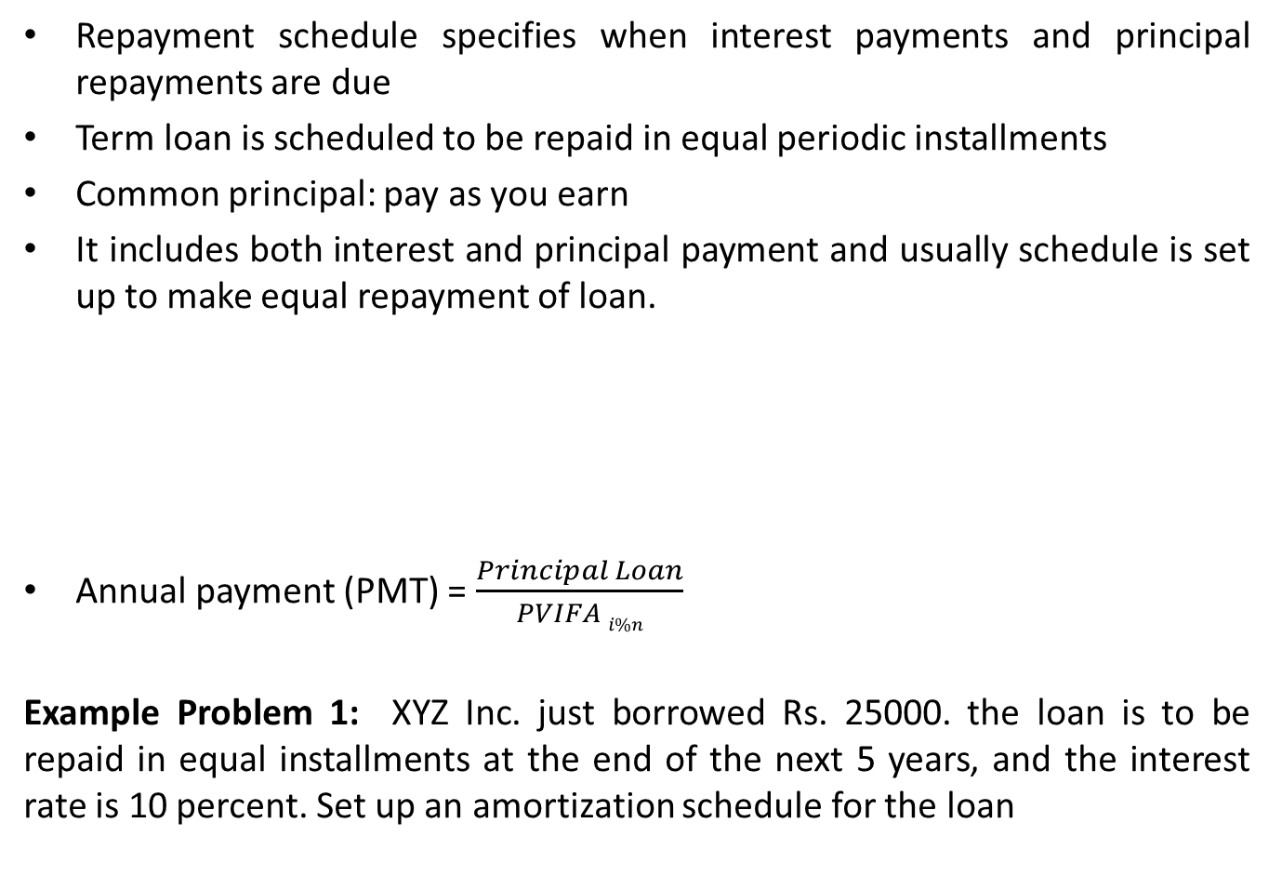
Loan Amortization
Repayment schedule specifies when interest payments and principal repayments are due
Term loan is scheduled to be repaid in equal periodic installments
Common principal: pay as you earn
It includes both interest and principal payment and usually schedule is set up to make equal repayment of loan.
Annual payment (PMT) = $\frac{Principal Loan}{PVIFA i\%n}$
Example Problem 1: XYZ Inc. just borrowed Rs. 25000. the loan is to be repaid in equal installments at the end of the next 5 years, and the interest rate is 10 percent. Set up an amortization schedule for the loan
Year | Beginning Principal | Annual Payment (PMT) | Interest Amount | Repayment of Principal | Remaining Balance
 | A | B | C = A × I% | D = B – C | E = A - D

Slide 5
Security Provision and Protective Covenants
Security Provision
Affirmative Covenants
Negative Covenants
Restrictive Covenants
Default Provision

Slide 6
Advantages and Disadvantages of Term Loan
Advantages
Less costly source of financing
Flexibility in financial or capital structure
No interference in the business operation
Enjoy tax saving on interest expenses
Disadvantages:
Interest on debt is permanent burden
Most risky source of financing
Fixed maturity period
Contain restrictive covenants
Creditworthy firm with adequate collateral

Slide 7
Bonds
Debt capital instruments of long term financing
Long term Promissory note
Issuer promise to pay fixed interest for a specified time interval on specified date and repays principal on maturity
Interval may be quarterly or semiannually or annually
Issuer must prepare bond indenture while issuing bonds
Types of bonds:
On basis of issuers:
Treasury Bond
Corporate Bond
Municipal Bond
Foreign Bond
Characteristic of Bond
Par value Maturity Date Coupon Interest Rate Call Provision
Indenture Convertibility Trustee Sinking Fund Bonds With Warrants

Slide 8
Types of Corporate Bond
Mortgage Bonds
Debenture
Simple or Naked Debenture
Mortgage Debenture
Redeemable Debenture
Irredeemable Debenture
Registered Debenture
Bearer Debenture
Subordinate Debenture
Income Bond
Convertible Bonds
Callable and Putable Bonds

Slide 9
Bonds Innovation
Zero-Coupon Bond
Floating Rate Bonds
Indexed Bonds
Junk Bonds
Specific Debt Control Features
Bond Indenture
Debtor Corporation
Bond Holders
Trustee
Call Provision
Sinking Fund

Slide 10
Advantages and Disadvantages of Long Term Debt
From Issuer’s Viewpoint:
Advantages
Less Costly
Marketability
Flexibility in Capital Structure
Facility of Trading on Equity
Disadvantages
Burden of fixed interest
Increase Financial Liabilities
Possibility of Insolvency
Reduces Company’s Goodwill
Financial Risk

Slide 11
Advantages and Disadvantages of Long Term Debt
From Investors’s Viewpoint:
Advantages
Less Risky Investment
Fixed and Stable Income
Control
Right of Conversion
Liquidity
Disadvantages
No voting right
Taxable Income
No Participant in Earning

Slide 12
Bond Valuation Model
The valuation method states that the intrinsic value of an asset is equal to the sum of the present value of the asset’s cash flow.
Value of Bond (V₀) = PV of coupon payment + PV of maturity value
Where, V₀ = Current value of assets
CF_{n} = Expected future cash flows in period (t)
k = Investor’s required rate of return(Cost of capital)
n = Expected life of assets
Example Problem: Assume that the cash flow of an investment are Rs 2,000 and Rs 4,000 in year 1 and 2 respectively and discount rate is 20 percent. Using the capitalization of cash flow method, calculate the value of financial assets.

Slide 13
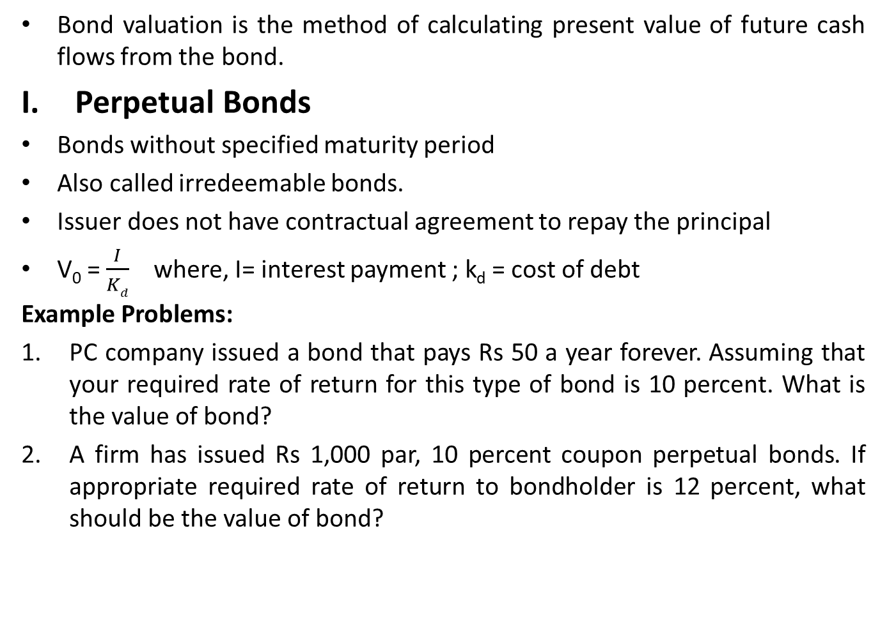
Valuation of Bonds
Bond valuation is the method of calculating present value of future cash flows from the bond.
Perpetual Bonds
Bonds without specified maturity period
Also called irredeemable bonds.
Issuer does not have contractual agreement to repay the principal
V₀ = $\frac{I}{Kd}$ where, I= interest payment ; k_{d} = cost of debt
Example Problems:
PC company issued a bond that pays Rs 50 a year forever. Assuming that your required rate of return for this type of bond is 10 percent. What is the value of bond?
A firm has issued Rs 1,000 par, 10 percent coupon perpetual bonds. If appropriate required rate of return to bondholder is 12 percent, what should be the value of bond?

Slide 14
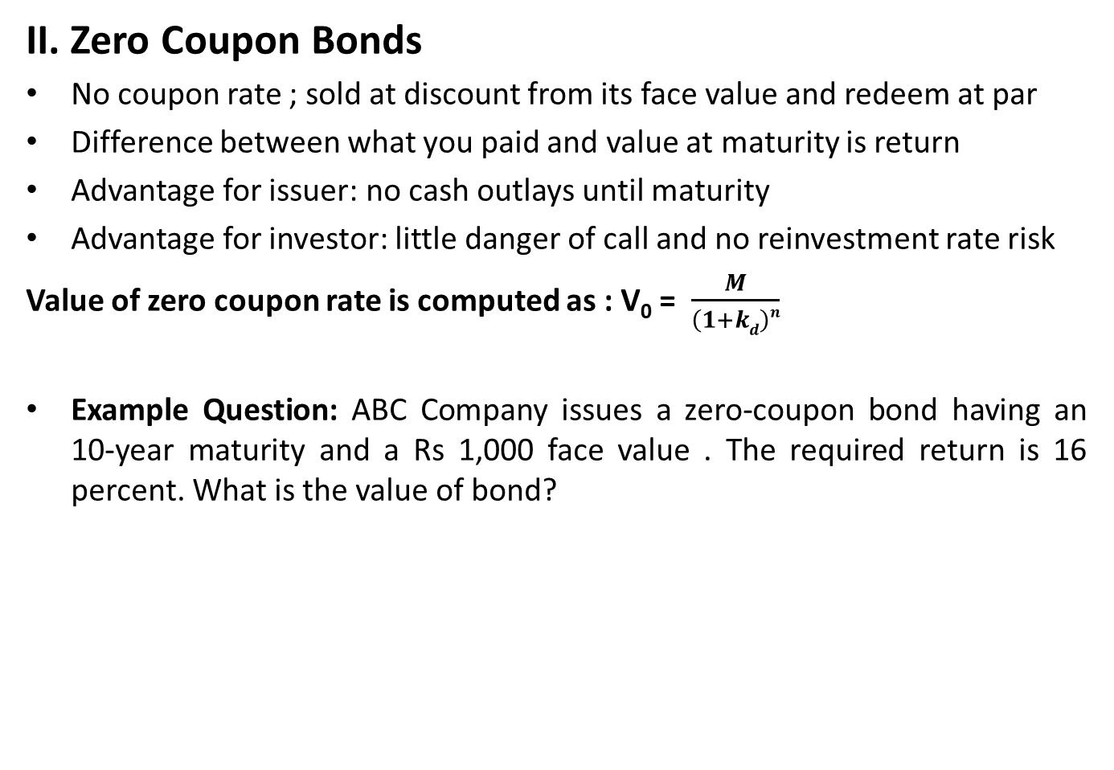
Valuation of Bonds
II. Zero Coupon Bonds
No coupon rate ; sold at discount from its face value and redeem at par
Difference between what you paid and value at maturity is return
Advantage for issuer: no cash outlays until maturity
Advantage for investor: little danger of call and no reinvestment rate risk
Value of zero coupon rate is computed as : V₀ = $\frac{M}{\left(1+kd\right)n}$
Example Question: ABC Company issues a zero-coupon bond having an 10-year maturity and a Rs 1,000 face value . The required return is 16 percent. What is the value of bond?

Slide 15
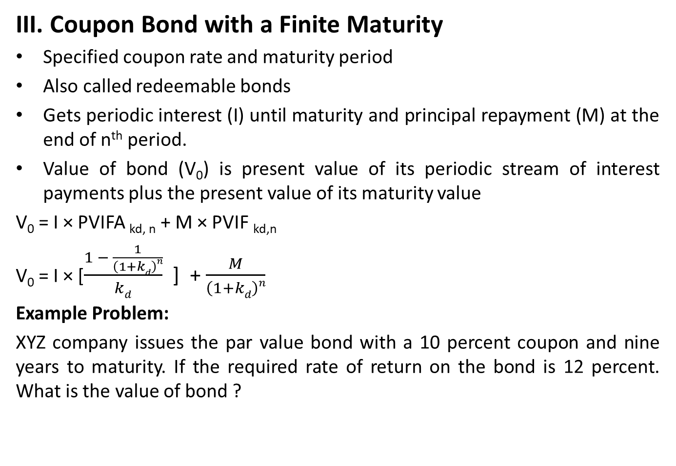
Valuation of Bonds
III. Coupon Bond with a Finite Maturity
Specified coupon rate and maturity period
Also called redeemable bonds
Gets periodic interest (I) until maturity and principal repayment (M) at the end of n^{th} period.
Value of bond (V₀) is present value of its periodic stream of interest payments plus the present value of its maturity value
V₀ = I × PVIFA _{kd, n} + M × PVIF _{kd,n}
V₀ = I × [$\frac{1 − \frac{1}{\left(1+kd\right)n}}{kd}$ ] + $\frac{M}{\left(1+kd\right)n}$
Example Problem:
XYZ company issues the par value bond with a 10 percent coupon and nine years to maturity. If the required rate of return on the bond is 12 percent. What is the value of bond ?

Slide 16
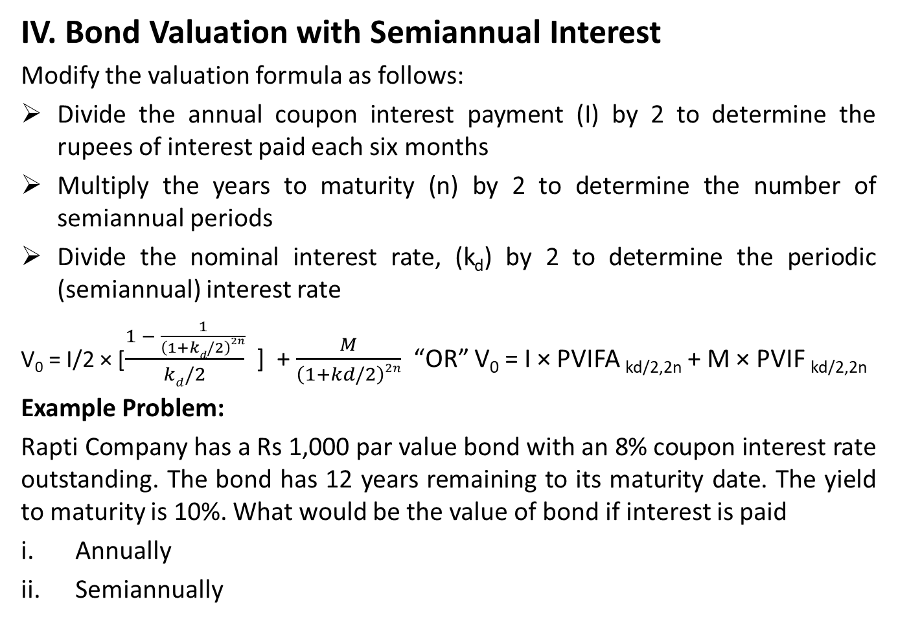
Valuation of Bonds
IV. Bond Valuation with Semiannual Interest
Modify the valuation formula as follows:
Divide the annual coupon interest payment (I) by 2 to determine the rupees of interest paid each six months
Multiply the years to maturity (n) by 2 to determine the number of semiannual periods
Divide the nominal interest rate, (k_{d}) by 2 to determine the periodic (semiannual) interest rate
V₀ = I/2 × [$\frac{1 − \frac{1}{\left(1+kd/2\right)2n}}{kd/2}$ ] + $\frac{M}{\left(1+kd/2\right)2n}$ “OR” V₀ = I × PVIFA _{kd/2,2n} + M × PVIF _{kd/2,2n}
Example Problem:
Rapti Company has a Rs 1,000 par value bond with an 8% coupon interest rate outstanding. The bond has 12 years remaining to its maturity date. The yield to maturity is 10%. What would be the value of bond if interest is paid
Annually
Semiannually

Slide 17
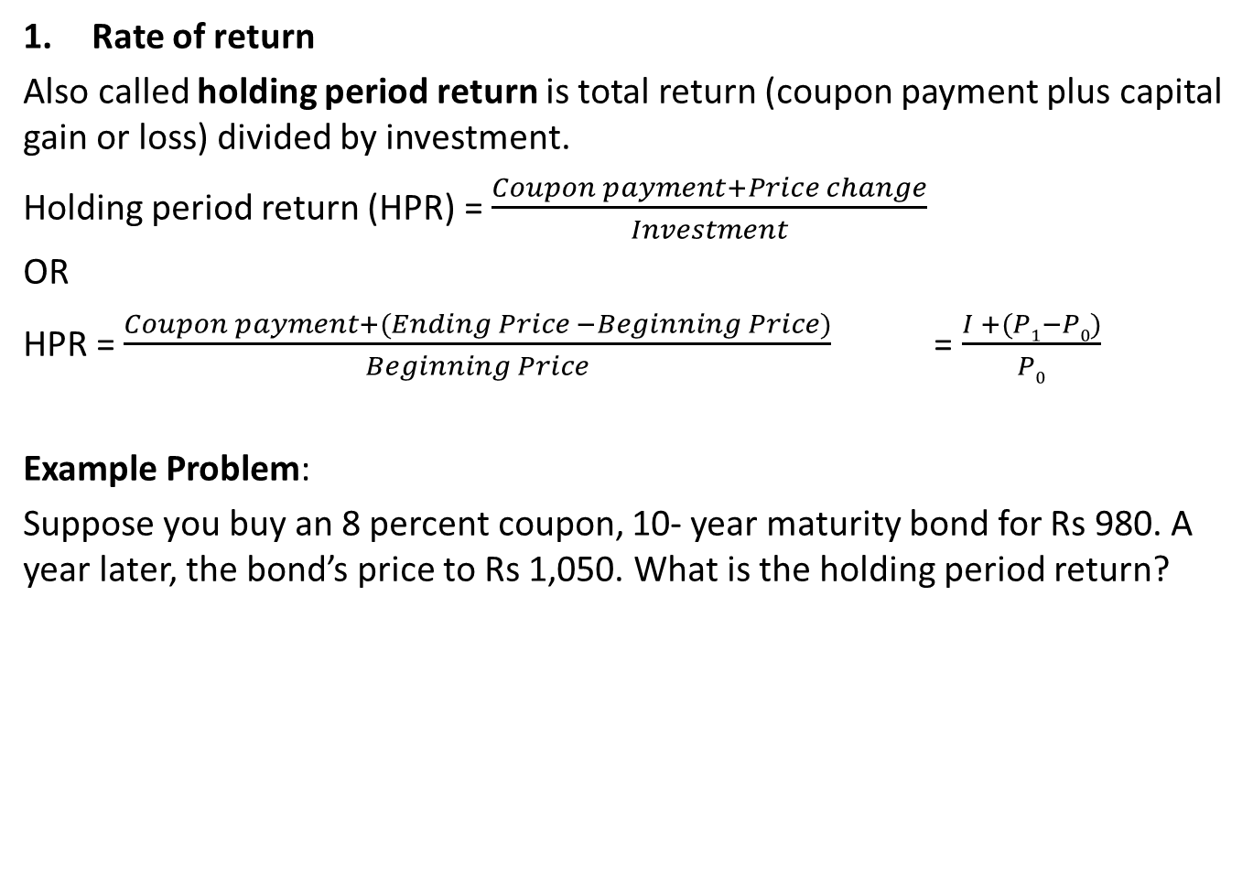
Bond Yields
Rate of return
Also called holding period return is total return (coupon payment plus capital gain or loss) divided by investment.
Holding period return (HPR) = $\frac{Coupon payment+Price change}{Investment}$
OR
HPR = $\frac{Coupon payment+(Ending Price −Beginning Price)}{Beginning Price}$ = $\frac{I +(P1−P0)}{P0}$
Example Problem:
Suppose you buy an 8 percent coupon, 10- year maturity bond for Rs 980. A year later, the bond’s price to Rs 1,050. What is the holding period return?

Slide 18
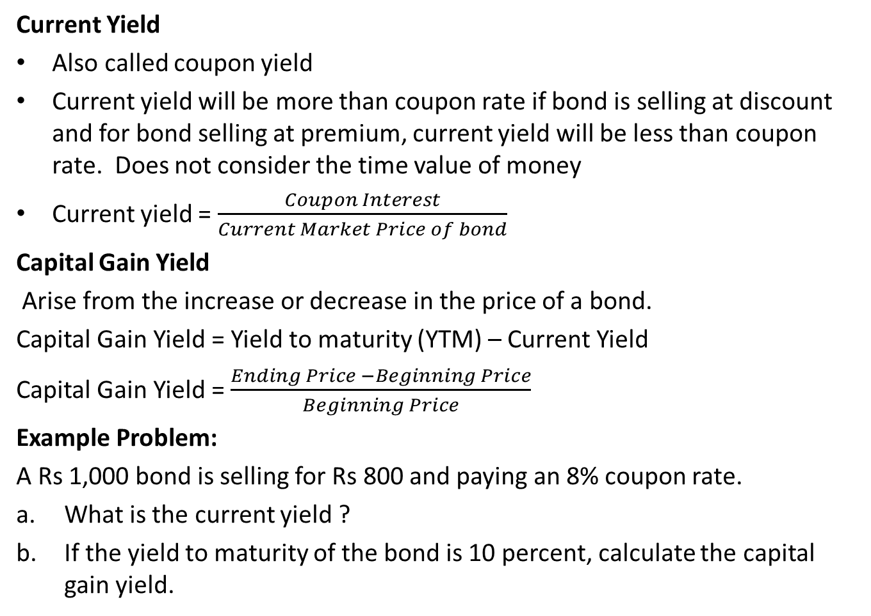
Current Yield and Capital Gain Yield
Current Yield
Also called coupon yield
Current yield will be more than coupon rate if bond is selling at discount and for bond selling at premium, current yield will be less than coupon rate. Does not consider the time value of money
Current yield = $\frac{Coupon Interest}{Current Market Price of bond}$
Capital Gain Yield
Arise from the increase or decrease in the price of a bond.
Capital Gain Yield = Yield to maturity (YTM) – Current Yield
Capital Gain Yield = $\frac{Ending Price −Beginning Price}{Beginning Price}$
Example Problem:
A Rs 1,000 bond is selling for Rs 800 and paying an 8% coupon rate.
What is the current yield ?
If the yield to maturity of the bond is 10 percent, calculate the capital gain yield.

Slide 19
Yield to Maturity (YTM)
Anticipated rate of return on bond if it is hold until the maturity date.
Rate that equals the present value of bond’s payment with current market price of the bond.
It considers all cash flows received over the life of an issue.
Other things being equal, higher the YTM, the more attractive it is to investors.
Computed under certain assumptions:
Bond will be held until maturity.
Coupons are immediately reinvested at YTM
Bond will not be called or redeemed by the issuer before maturity
All cash flows will occur as indicated in the indenture

Slide 20
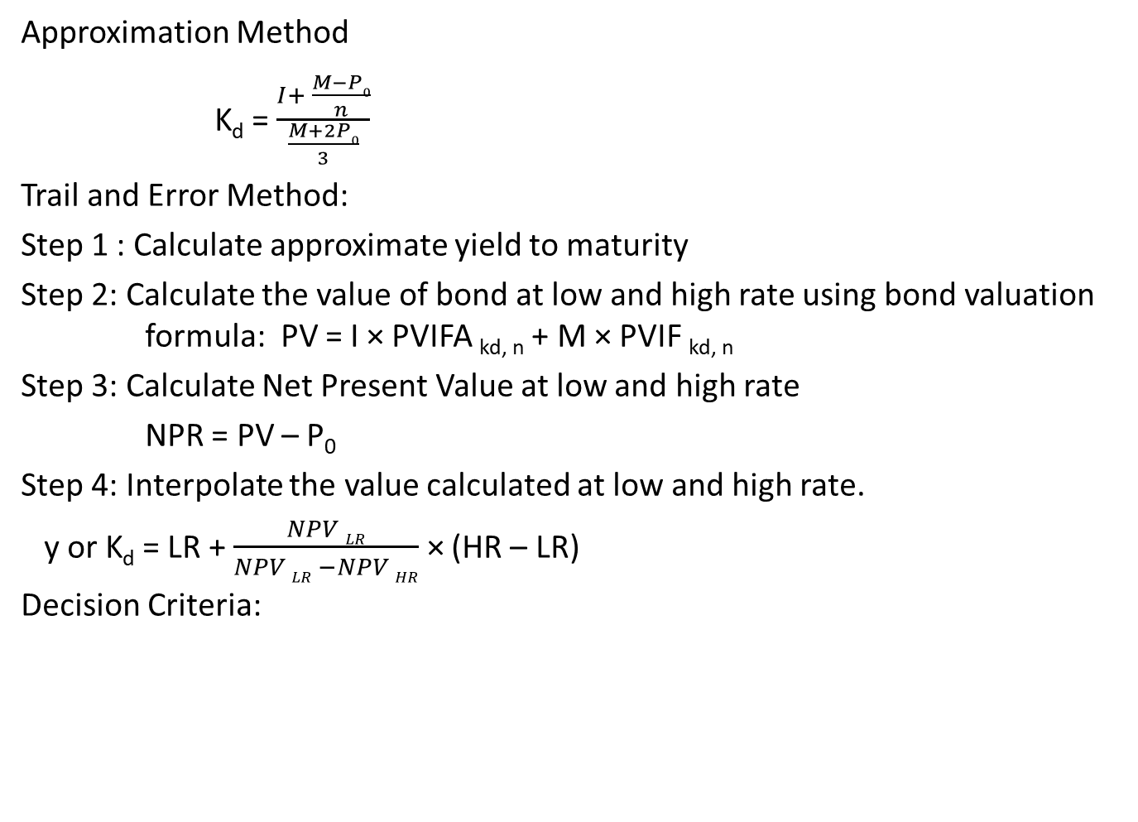
YTM for Coupon Bond
Approximation Method
K_{d} = $\frac{I+ \frac{M−P0}{n}}{\frac{M+2P0}{3}}$
Trail and Error Method:
Step 1 : Calculate approximate yield to maturity
Step 2: Calculate the value of bond at low and high rate using bond valuation formula: PV = I × PVIFA _{kd, n} + M × PVIF _{kd, n}
Step 3: Calculate Net Present Value at low and high rate
NPR = PV – P₀
Step 4: Interpolate the value calculated at low and high rate.
y or K_{d} = LR + $\frac{NPV LR}{NPV LR −NPV HR}$ × (HR – LR)
Decision Criteria:
If | Then | Reason
YTM > minimum required rate of return | Buy the Bond | Undervalued
YTM < minimum required rate of return | Do not buy the Bond | Overvalued
YTM = minimum required rate of return | Be indifferent | Correctly Valued

Slide 21
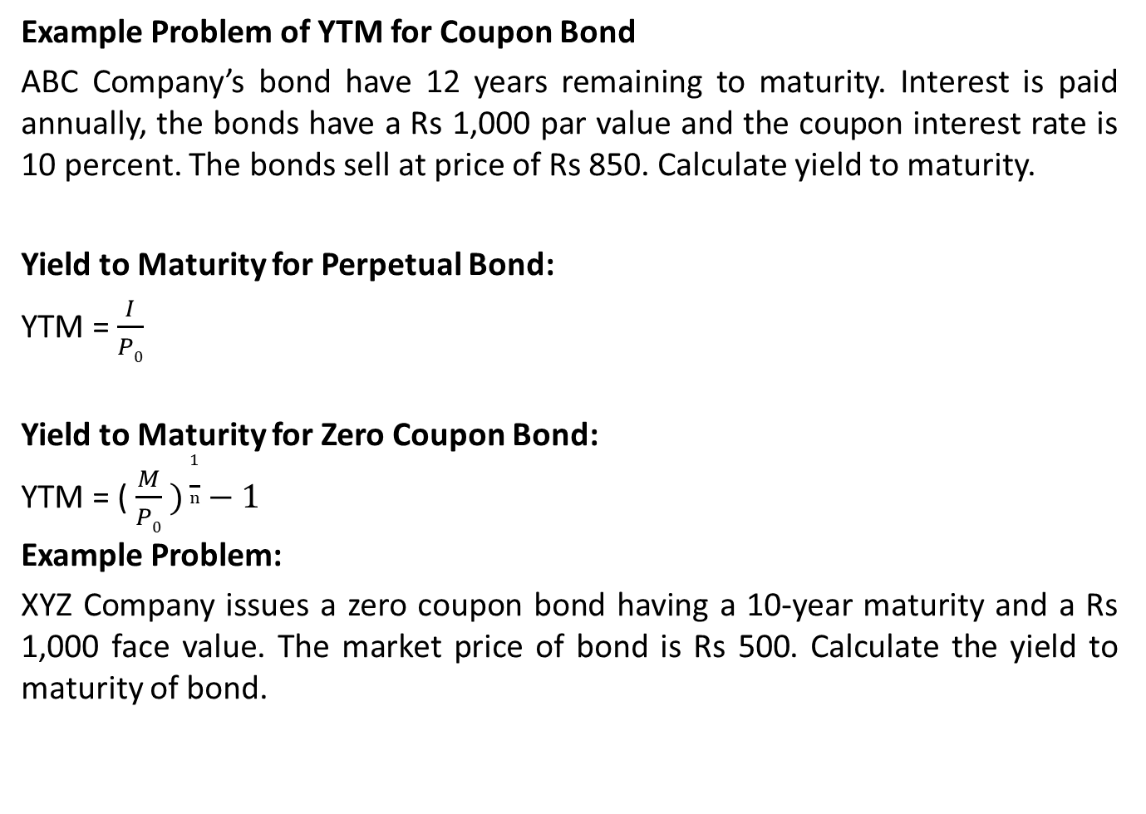
YTM
Example Problem of YTM for Coupon Bond
ABC Company’s bond have 12 years remaining to maturity. Interest is paid annually, the bonds have a Rs 1,000 par value and the coupon interest rate is 10 percent. The bonds sell at price of Rs 850. Calculate yield to maturity.
Yield to Maturity for Perpetual Bond:
YTM = $\frac{I}{P0}$
Yield to Maturity for Zero Coupon Bond:
YTM = ($\frac{M}{P0} )\frac{1}{n}−1$
Example Problem:
XYZ Company issues a zero coupon bond having a 10-year maturity and a Rs 1,000 face value. The market price of bond is Rs 500. Calculate the yield to maturity of bond.

Slide 22
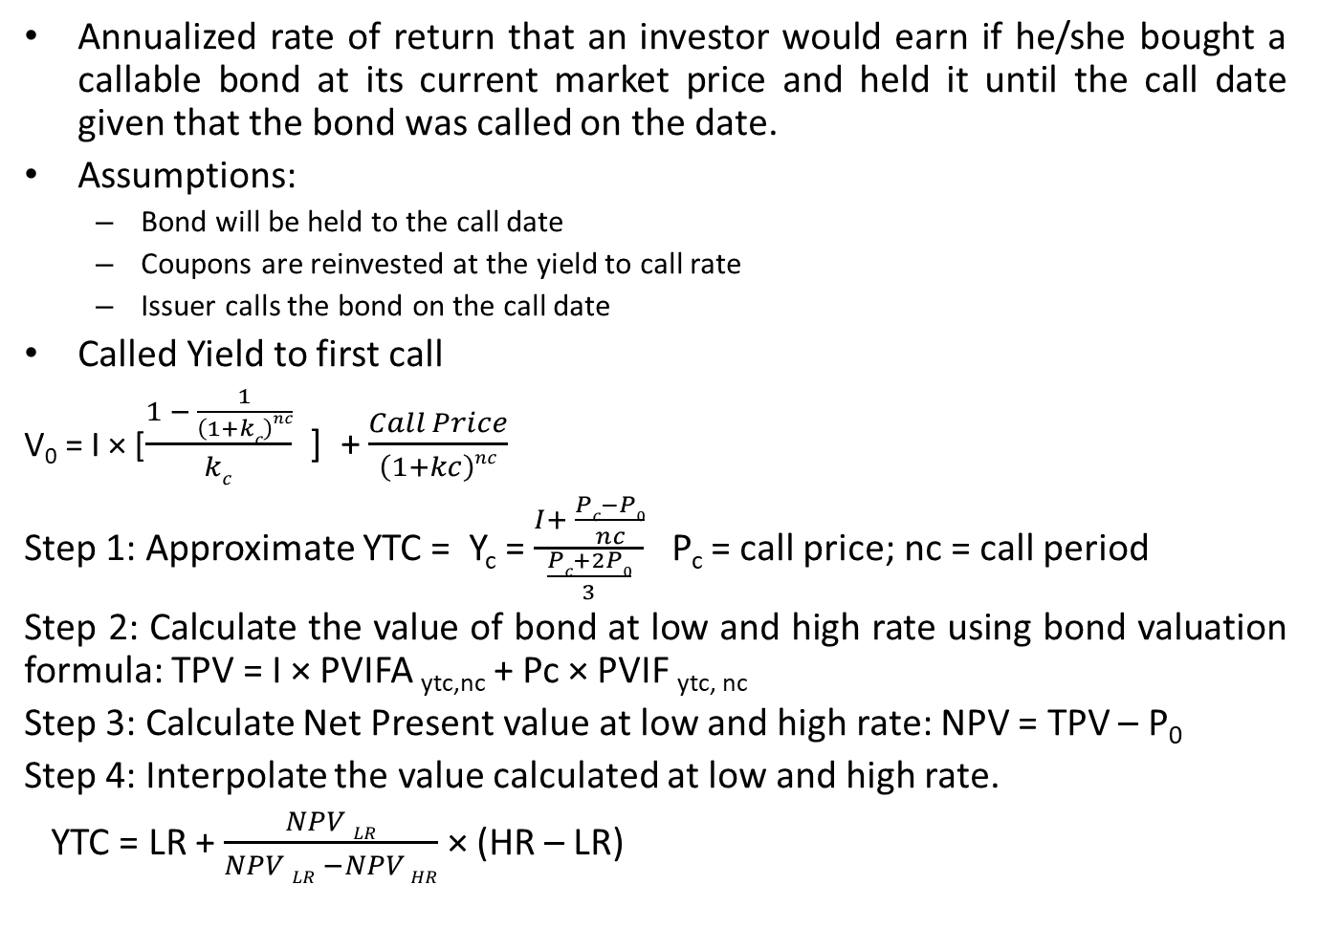
Yield To Call (YTC)
Annualized rate of return that an investor would earn if he/she bought a callable bond at its current market price and held it until the call date given that the bond was called on the date.
Assumptions:
Bond will be held to the call date
Coupons are reinvested at the yield to call rate
Issuer calls the bond on the call date
Called Yield to first call
V₀ = I × [$\frac{1 − \frac{1}{\left(1+kc\right)nc}}{kc}$ ] + $\frac{Call Price}{\left(1+kc\right)nc}$
Step 1: Approximate YTC = Y_{c} = $\frac{I+ \frac{Pc−P0}{nc}}{\frac{Pc+2P0}{3}}$ P_{c} = call price; nc = call period
Step 2: Calculate the value of bond at low and high rate using bond valuation formula: TPV = I × PVIFA _{ytc,nc} + Pc × PVIF _{ytc, nc}
Step 3: Calculate Net Present value at low and high rate: NPV = TPV – P₀
Step 4: Interpolate the value calculated at low and high rate.
YTC = LR + $\frac{NPV LR}{NPV LR −NPV HR}$ × (HR – LR)

Slide 23
YTC
Example Problem
Ram Singh recently purchased a bond with a Rs 1,000 face value, a 10% coupon rate, and four years to maturity. The bond makes annual payments, the first to be received one year from now. Ram paid Rs 1,032.40 for the bond. If the bond can be called two years from now at a price of Rs 1,100, what is the yield to call?
Realized Rate of Return
The annualized rate of return on the bond that is realized if the interim coupons are reinvested at other rate than YTM

Slide 24
Preferred Stock
Long term sources of financing
Fixed amount of dividend out of earning of company after payment of debenture interest and tax
Does not convey voting power
Preferred dividend are usually cumulative
Preferred dividend are not tax deductible expenses

Slide 25
Features of Preferred Stock
Fixed Dividend
Cumulative Dividends
Par Value
Participative Feature
Voting Rights
Claims on Income and Assets
Redemption / Retirement
Sinking Fund
Call Provision
Convertibility

Slide 26
Types of Preferred Stock
Cumulative and Non Cumulative
Participating and Non Participating
Redeemable and Irredeemable
Convertible and Non Convertible

Slide 27
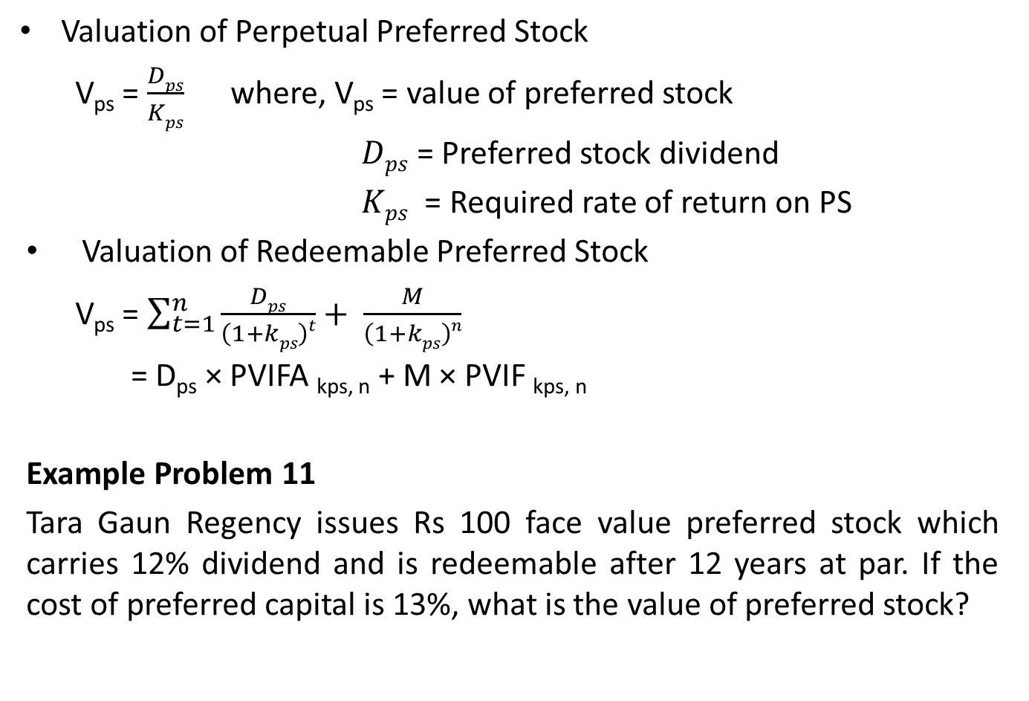
Preferred Sock Valuation
Valuation of Perpetual Preferred Stock
V_{ps} = $\frac{Dps}{Kps}$ where, V_{ps} = value of preferred stock
$Dps$ = Preferred stock dividend
$Kps$ = Required rate of return on PS
Valuation of Redeemable Preferred Stock
V_{ps} = $\sum_{t=1}^{n}{\frac{Dps}{\left(1+kps\right)t}}+ \frac{M}{\left(1+kps\right)n}$
= D_{ps} × PVIFA _{kps, n} + M × PVIF _{kps, n}
Example Problem 11
Tara Gaun Regency issues Rs 100 face value preferred stock which carries 12% dividend and is redeemable after 12 years at par. If the cost of preferred capital is 13%, what is the value of preferred stock?

Slide 28
Advantages and Disadvantages of Preferred Stock
From Issuer’s Viewpoint:
Advantages
Fixed Dividend
Flexibility in Capital Structure
Non interference in Management
Strengthens the equity base
Disadvantages
Permanent Burden
Costlier than Debt
Difficult to Sale
Seniority Claim

Slide 29
Advantages and Disadvantages of Preferred Stock
From Investors' Viewpoint:
Advantages
Stable Income
Priority in Earning and Assets
Tax Exemption
Disadvantages
Limited Return
Limited Voting Right
Possibility of Redemption during Recession
Seniority Claim

Slide 30
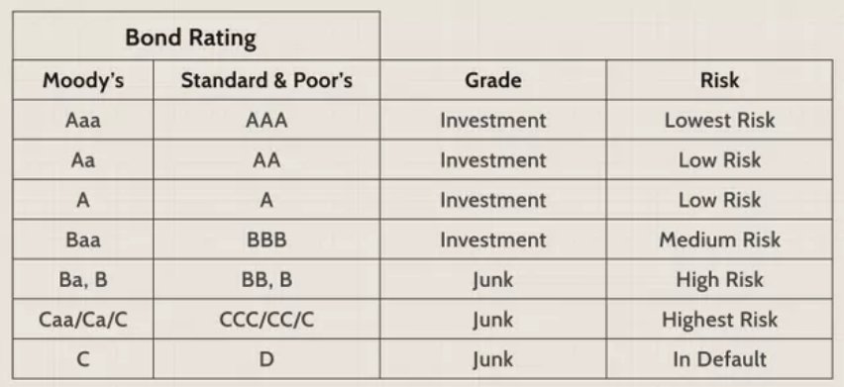
Bond Rating
Also called quality rating of bond done on the basis of default risk
3 main bond rating agencies in the United States are:
Fitch Rating
Standard & Poor’s Global Rating (S & P Global Rating)
Moody’s Investment Service

Slide 31
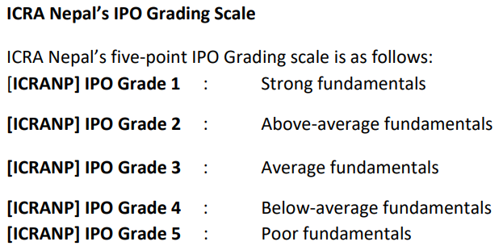
Bond Rating
ICRA Nepal Limited (ICRA Nepal), the first Credit Rating Agency in Nepal, is a Subsidiary of ICRA Limited (ICRA) of India. It was incorporated on November 11, 2011 and granted license by the Securities Board of Nepal (SEBON) on October 3, 2012

Slide 32
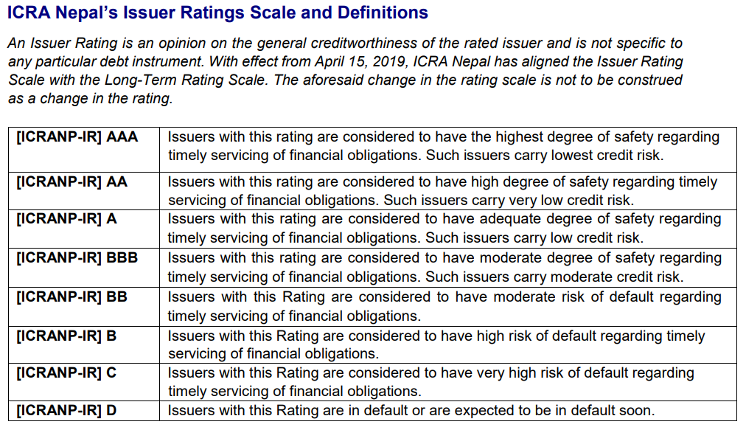
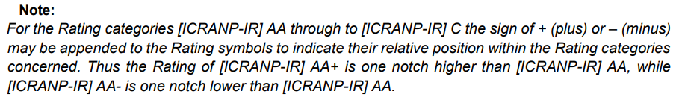
Bond Rating

Slide 33
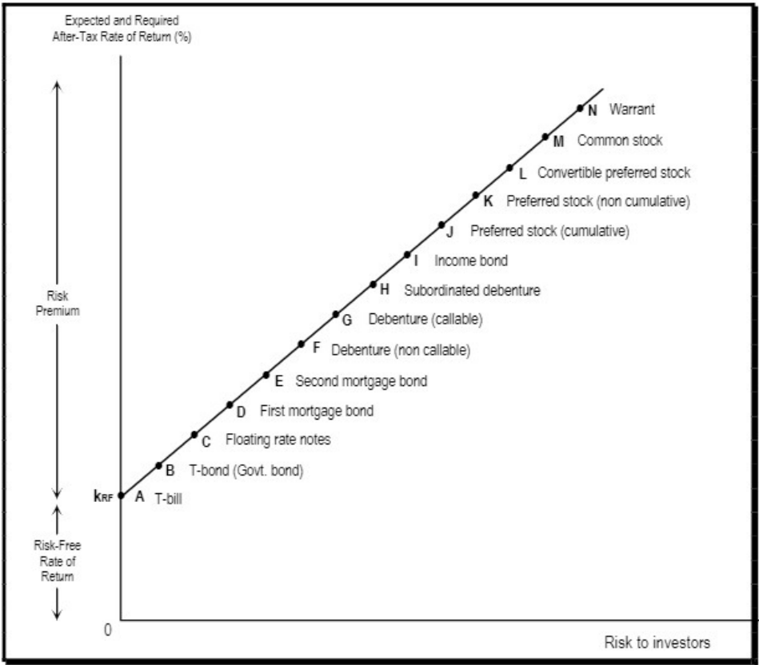
Ranking of Securities

